Slide 1
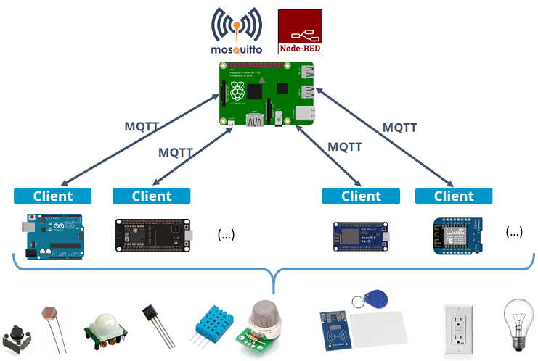
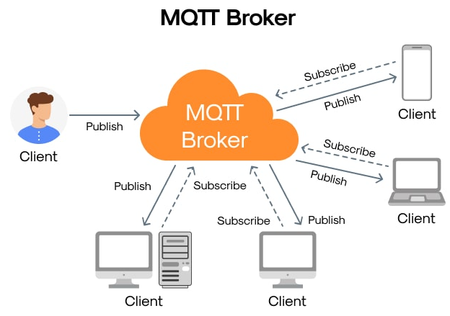
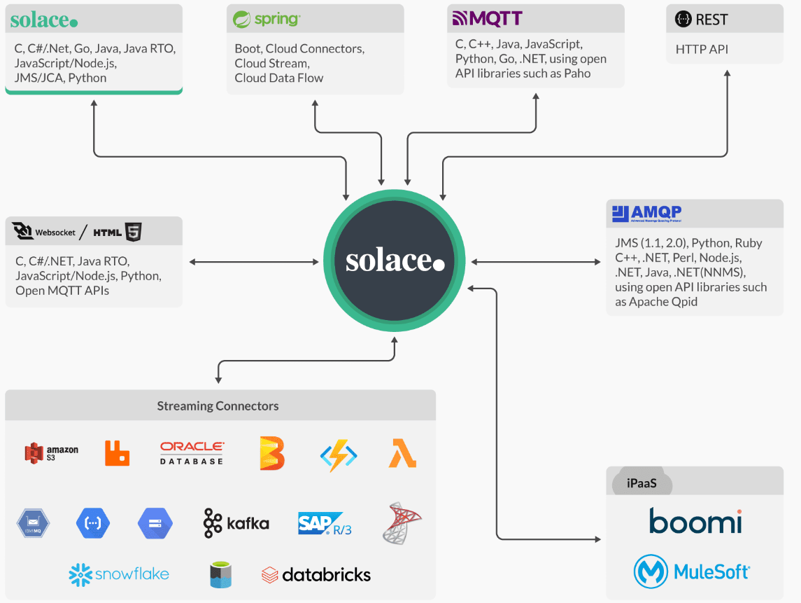
MQTT, or Message Queuing Telemetry Transport, is a lightweight, publish-subscribe based messaging protocol designed for resource-constrained devices and low-bandwidth, high-latency networks. It's widely used in the Internet of Things (IoT) for efficient communication between devices like sensors, actuators, and other components.
For those messages that are going to come through MQTT Broker –
could be somethings simple as of an integer value 0, 1, 2, 3 or it could be
something more complicated like a Json payload

Slide 2
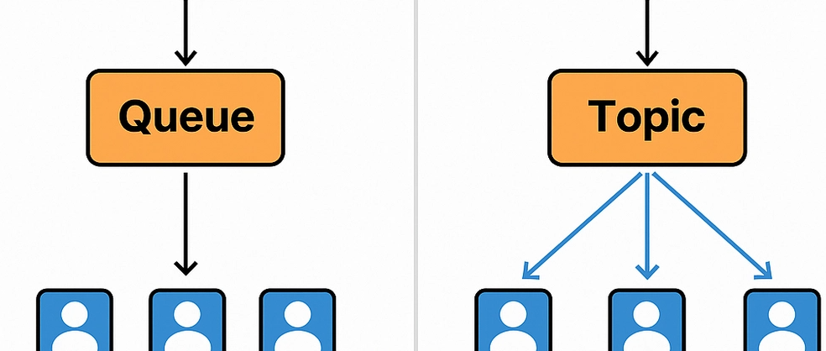
What Is a Queue?
A queue follows a point-to-point communication model: messages are sent by a producer and consumed by only one consumer. Once a message is processed, it is removed from the queue.
Key characteristics:
Each message is processed by one and only one consumer.
Guarantees single delivery of each message.
Useful for load balancing between multiple consumers.
Maintains message order (FIFO – First In, First Out).
When to use queues:
Background processing.
Order or job handling systems.
Distributing workload across workers.
What Is a Topic?
A topic uses a publish-subscribe (pub/sub) model. In this case, a message published to a topic is received by all subscribers.
Key characteristics:
Multiple consumers receive the same message.
Full decoupling between producers and consumers.
Enables more flexible, event-driven architectures.
Subscribers can process messages at their own pace.
When to use topics:
Real-time notifications or broadcasting.
Event-driven systems.
Integrations where multiple services must react to the same event.
Conclusion
Both queues and topics are fundamental in modern systems. Choosing between them depends on your business and technical needs:
Use queues when each task should be processed once, by only one worker.
Use topics when a message must be delivered to multiple subscribers.
Mastering both models will help you design systems that are scalable, resilient, and easy to maintain.

